Slide 1

Welcome to the Center of Excellence on Internet of Things
Raghunandan.Srinath@nmit.ac.in, Professor, Dept of ECE
Nitte Meenakshi Institute of Technology

Slide 2
Plan for this session
What is the Internet of Things?
A few Applications
Some Technology enablers
What you will learn in this 5-Sem Program

Slide 3
What is the Internet of Things?
Internet – connected computing nodes
Internet of Things – Everything is connected
Sensors & Actuators – connect to the physical world
Miniaturization, Connection, Automation
Billions of sensors / devices
Widespread deployment

Slide 4
Examples of IoT Applications

Slide 5
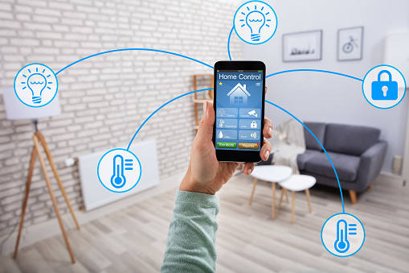
Smart home
Intelligence, Automation
Home controller
Comfort, Saving energy
Building Energy Management
Remote management

Slide 6
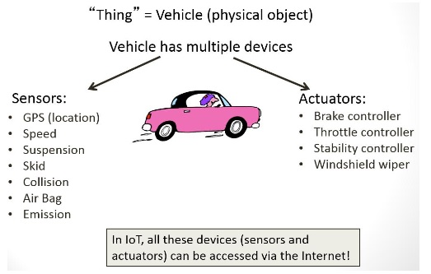
Smart Cars
ADAS – Advanced Driver Assistance Systems
Autonomous Cars
Smart Transportation
Vehicle-to-Vehicle Communication
Infotainment

Slide 7
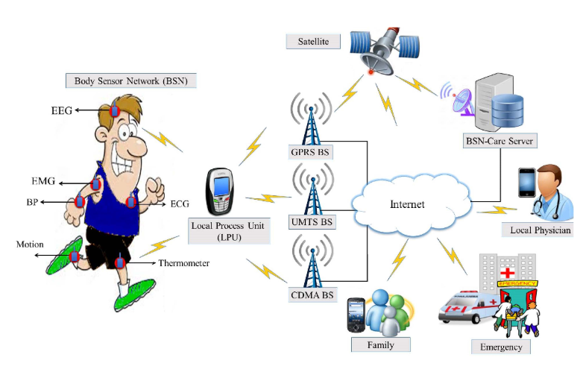
Smart healthcare
Sensors – ECG, EEG, Temperature, BP, …
Assistance to Patients, Doctors, Elderly, …
Fitness
Remote care
Smart ambulance services

Slide 8
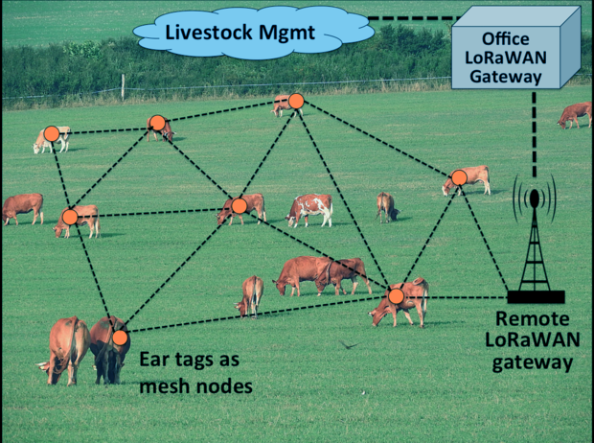
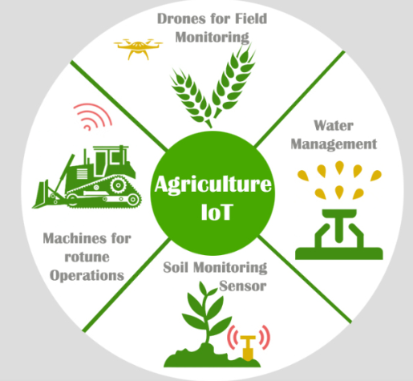
Smart agriculture
Sensors – soil characteristics, moisture, temperature, water level, flow, ...
Assistance to farmers
Yield enhancement

Slide 9
Some other Smart applications
Smart energy
Smart manufacturing
Smart water management
Smart pollution control
Smart waste management
Smart cities

Slide 10
Typical aspects in most applications
Sensors
Networking
Analytics
Connectivity, Edge computing
Actuators
Specifics depend on the application
Many applications involve Embedded Real-time systems, Cloud computing
Microcontrollers
Analytics – often involves Databases, Machine learning
Distributed deployment

Slide 11
Computation
8051
Raspberry Pi 3B
ARM Cortex M3
Rugged Board
Microprocessors
Microcontrollers = MP + I/O Ports, RAM/ROM, Timers, …
Microcontroller Boards = MC + Peripherals, LCD, USB, Motor driver ICs, SD card slot, …
Edge computing
Parallel computing
CPU, DSP, Multi-core Processors, Graphics / Tensor Processing Units
Servers, Cloud services

Slide 12
Development
C, Python, Embedded C, …
Linux (RTOS)
Processor-dependent Programming, Compilers, IDE, …
Microcontrollers + Sensors + Actuators + Network elements + …
Accessing cloud services – example: Amazon Web Services
Analytics … often using Machine Learning algorithms / libraries / tools

Slide 13
Connectivity & Networking
This is what makes anything a “Thing” in the Internet of Things
RFID, BT, Wi-Fi, ZigBee, USB, IPv4/IPv6, …
Network protocols
Machine-to-Machine communication

Slide 14
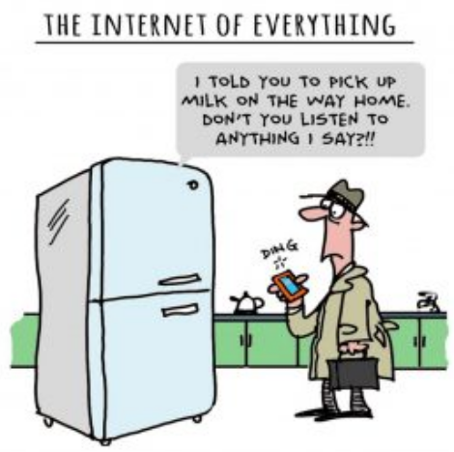
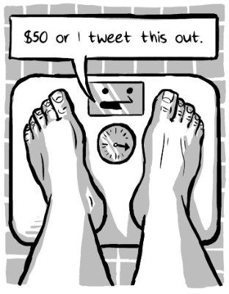

Slide 15
Challenges
Power management
Security
Very dynamic environment
Interoperability

Slide 16
Plan for the full 5-Sem program
Sem 3
Sem 4
Sem 5
Foundation
Communications
Networking
Protocols
SW Dev
Sem 6
Machine learning
Analytics
Sem 7
Industrial IoT
Security
Deployment (Projects)
Mobile & Cloud
Microcontrollers
Linux, Embedded C
Entirely Hands-on
Projects
Regular talks & Project reviews by Industry experts
Competitions

Slide 17
Plan for the first Semester
Introduction to Internet of Things | 9 Hours | Lead Faculty: Dr Venkatesh Rao Professor, Dept of CSE
Introduction to Operating Systems, Linux, GitHub | 6 Hours | Lead Faculty: Dr Sanjay Professor, Dept of ISE
Microcontrollers, ARM, Embedded C | 36 Hours | Lead Faculty: Prof Sankar, Prof Sitaram Yaji Professors, Dept of ECE
Data structures and Algorithms for IoT | 1 Hour | Lead Faculty: Dr Madhu Assoc Prof, Dept of ISE

Slide 18
What is expected of you
Practice programming always
Go deeper than ready-made libraries
Get friendly with Linux
Get close to hardware
Projects
Hard work, beyond normal
Spirit of doing / making
Team work
Interact with Industry
Keep an eye on Tech trends
Communication – oral and written
Competitive spirit

Slide 19
